Slide 1
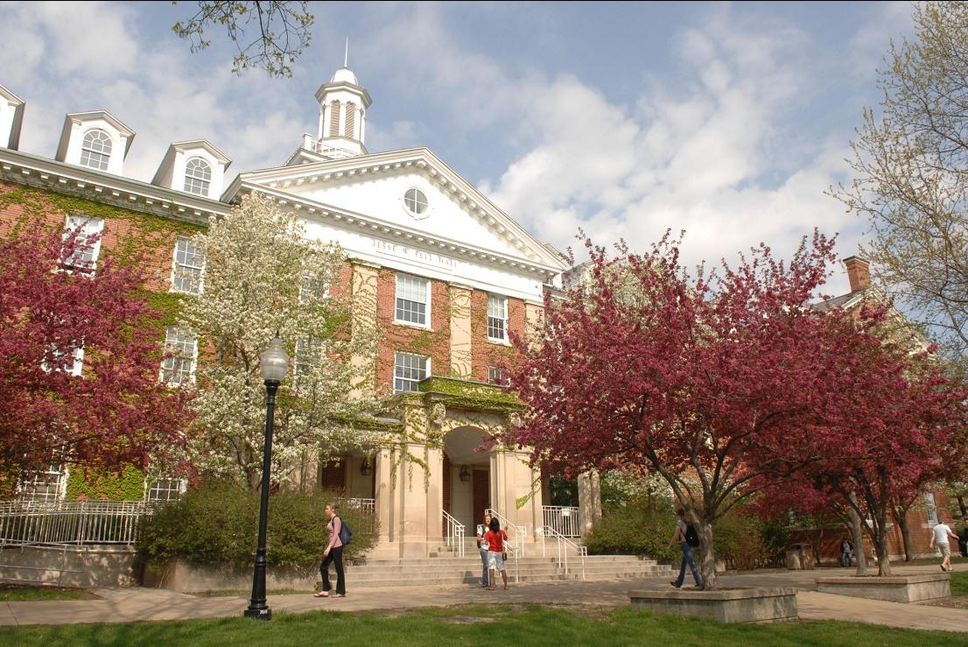
Planning for Sustainability

Slide 2
Commitment to Sustainability
Campus Wide Sustainability Policy
Illinois Green Government Coordinating Council’s Sustainable University Compact
American College and University Presidents Climate Commitment
United Nations’ Principles for Responsible Management Education

Slide 3
Surveys of Attitudes

Slide 4
Sustainability Ratings
Princeton Review
Petersons
STARS
Sustainable Endowments Institute
Illinois Sustainable University Compact

Slide 5
Areas Evaluated
Energy and Climate
Investments
Purchasing
Transportation
Dining
Operations and Maintenance
Resource/Waste Management
Administration, Policy and Planning
Academics
Outreach

Slide 6
Items Included in All
Local food options in Dining
Universal access for transit
Car share program
Climate commitment and GHG inventory
Recycling and composting
Policy requiring building to LEED silver or better
Generation/purchase of renewable energy

Slide 7
Green Team
Recommendations

Slide 8
Green Buildings
LEED building policy
Lifecycle costing
Support ESCO
Utilize renewable energy
Account for greenhouse gas emissions
Water conservation and treatment
Use green buildings as donor opportunities

Slide 9
Zero Waste
Require C&D recycling and reporting
Design for reduced paper consumption
Network printing
Hand dryers
Consider impacts to off-campus students

Slide 10
Living Laboratory
Nature paths/preserve
Community/Class garden
Natural water treatment
Renewable energy partnerships

Slide 11
Walkable/Bikeable Campus
Keep campus compact and focus on Quad
Revive west side of campus
Ease Main Street crossings
Staircases that encourage use
Covered bike storage/ indoor storage for new housing

Slide 12
Leadership in Energy and Environmental Design
Categories
Ratings
Sustainable Sites
Water Conservation
Energy & Atmosphere
Materials & Resources
Indoor Envi. Quality
Innovation
Certified 40–49pts
Silver 50–59 pts
Gold 60–79 pts
Platinum 80 pts & above

Slide 13
Cost
 | New Construction | Existing Building
Registration | $900 | $900
Certification
> 50,000 ft² | $2,250 | $1,500
50,000 - 500,000 ft² | $0.045/ft² | $0.03
< 500,000 ft² | $22,500 | $15,000
Example: | Rec Center: $8,850 | Schroeder Hall: $3,000

Slide 14
Julie North
Director of Parking and
Transportation
jenorth@ilstu.edu
309-438-8397
Enid Cardinal, LEED AP
ISU Sustainability Coordinator
ecardin@ilstu.edu
309-438-4425
greenteam.ilstu.edu
“Never doubt that a small, group of thoughtful, committed citizens can change the world. Indeed, it is the only thing that ever has.” … Margaret Mead

