Slide 1
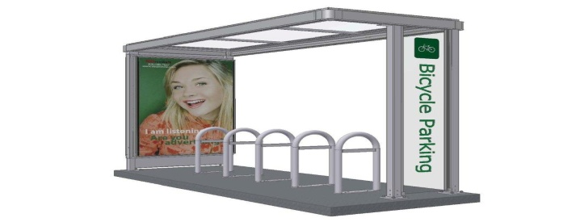
Illinois State University
Parking & Transportation Services
Master Planning and Parking
Julie E. North, Director
February 11, 2010

Slide 2
Parking Space Profile – Capacity & Utilization
Transit Survey Results
BNPTS & ISU Partnership
Promoting Alternative Transportation Efforts
Parking Projections and Potential Needs
Reduction of Campus Residence Hall Students

Slide 3
Illinois State University Parking Profile
8,743 Parking Spaces
3 Major Parking Garages
1 Deck Under Julian
81 Surface Lots
420 Meters
Parking Permit Structure is organized by Zone
15 Different Permits

Slide 4
Survey Parameters
Web Process Implemented 11-16-09
Closed on 12-23-09
Total of 763 Responses
7% Faculty
38% Staff
55% Students
77% were aware of ISU “free” transit
23% were not aware

Slide 5
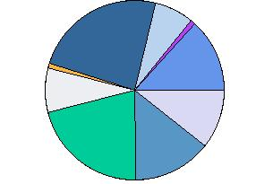
BNPTS Fixed Routes - Utilization
Yellow Route 17%
Orange H Route 21%
Green A Route 34%
Teal J Route 0%
Lime I Route 13%
Brown F Route 1%
Purple C Route 0%
Red B Route 37%
Blue E Route 11%
Aqua K Route 1%
Pink D Route 21%

Slide 6
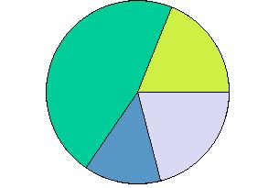
Fixed Route Non-Utilization
Buses Do Not Run Frequently Enough 31%
Too Long of a wait to make a transfer 20%
Routes are not convenient where I live 68%
Hours & Days of Service Not Compatible 28%

Slide 7
BNPTS & ISU PARTNERSHIP
Successfully negotiated a 3 year contract (1 year w/3 renewals)
Universal Access Agreement = $156,151.60
Red Bird Express = $167,691.50
Nite Ride/Late Nite = $80,895
Commercial Liability = $6,831.60
Grand Total = $411,569.70

Slide 8
Supporting Alternative ISU Transit Programs
Covered Bicycle Parking
New Transit Shelters
Way Finding Signage
New Transit Maps
Individual Transit Maps
Universal Access Transit Program
Red Bird Shuttle, Nite Ride & Late Nite Ride

Slide 9
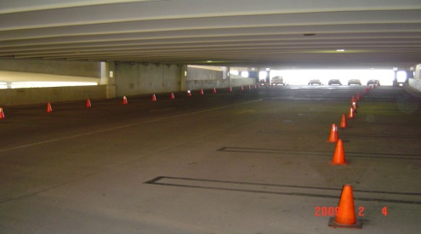
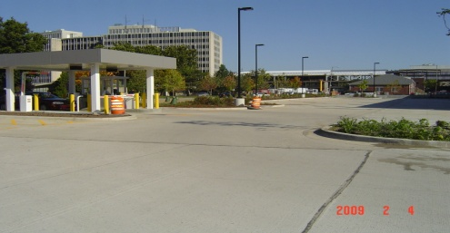
South University Garage Project
Opened 8-17-09
898 Spaces
Mixed – Use Parking
Hourly, Student Storage, Reserved Zone, Commuter
Never filled to capacity

Slide 10
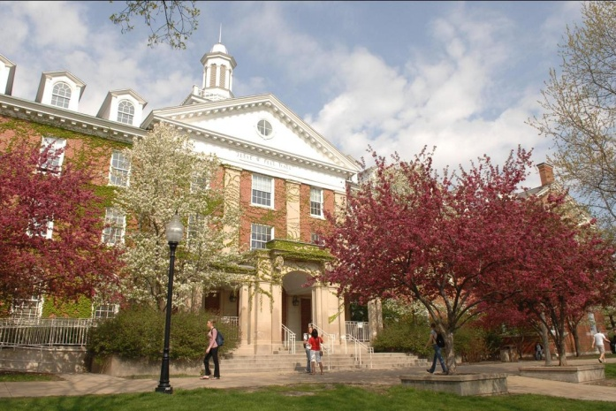
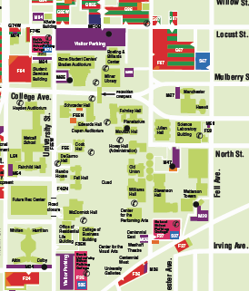
Quad Green Space & Surface Lots

Slide 11
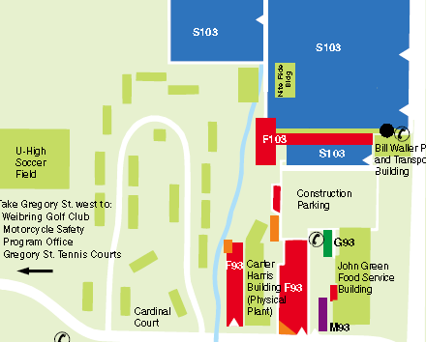
S103 – 484 Student Storage – Residential
Total Capacity - 513
A reduction in student residents will open these spaces to commuters.

Slide 12
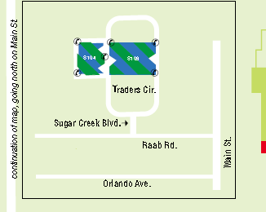
S104 & S105 Traders’ Circle
104 – 409 Spaces
105 – 413 Always empty

Slide 13
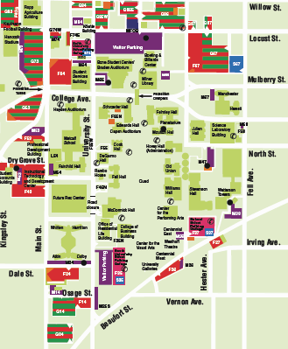
North Garage
South Garage
School Street Garage
Next Garage
South University
School Street
North Garage
*Proposed location (Trifecta)

